Slide 1
Linear Regression
Reading Output

Slide 2
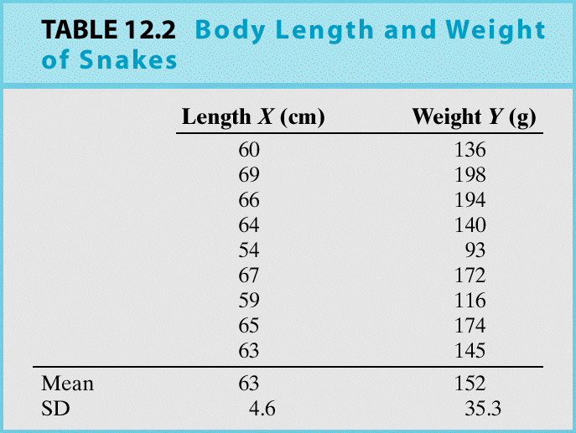
Example: Can we predict the weight of a snake simply by measuring its length?
Y = snake weight (g) X = snake length (cm)

Slide 3
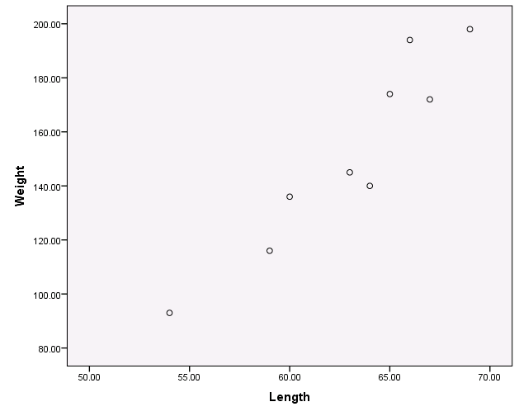
The snake data scatter plot shows a clear linear relation:

Slide 5
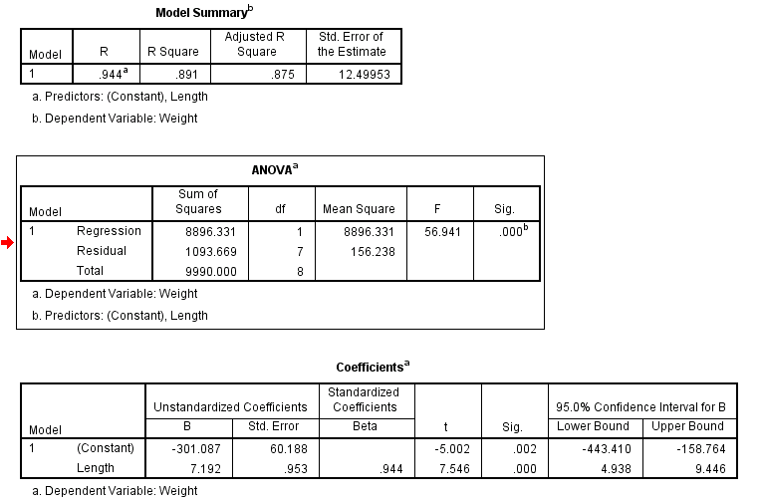
SPSS Linear Regression Output

Slide 6
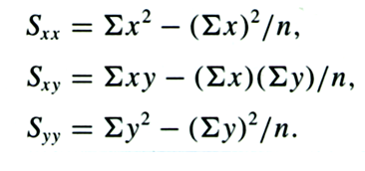
Recall the formulae for the intercept and slope can be found by

Slide 8
S_{xx}= 35893-(567²/9) = 172
S_{xy} = 87421-((567*1368)/9)=1237
S_{yy}= 217926-(1368²/9)=9990
b₁=1237/172=7.1918
b₀=152-(7.1918*63) = -301.0834

Slide 9
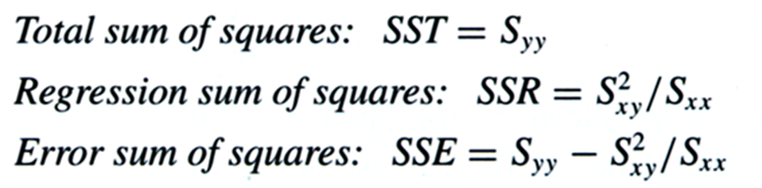
What about the ANOVA table?
SST = 9990
SSR = 1237²/172=8896.331
SSE = 9990-8896.331=1093.6686

Slide 10

Now r² and r
= 8896.331/9990=0.8905
r = square root of r² and the sign must match the sign of the slope = 0.9436

Slide 11
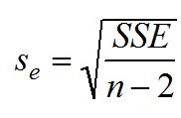
Standard error of the estimate, s_{e}
s_{e}=

Slide 12
Simple Linear Regression Model
For a quantitative response variable Y and a single quantitative explanatory variable X, the simple linear regression model is
Where the errors are independent of each other and follow a normal distribution, that is

Slide 13
Assumptions Concerning the Population Regression Line
We expect the average error e_{i} to be zero so the regression line passes through the conditional mean of Y.
The e_{i} have constant variance σ_{e}².
The e_{i} are normally distributed.
The e_{i} are independent.

Slide 14
Residuals
Residual = observed value – predicted value
or
Observed weight is 136 g when length is 60 cm
Predicted weight is 130.42 when length is 60 cm
Residual = 136- 130.42 = 5.58 which shows an underestimate

Slide 15
Checking Model Adequacy
The plot of residuals vs x-values should show NO interesting features. If you see something your model may be missing something.

Slide 16
Residual Standard Deviation
If the residuals show no interesting patterns when we plot them against x, we can look at how big they are as we are trying to make them as small as possible. Since their mean is always zero it is only sensible to look at how much they vary. The s_{e} gives us a measures of how much the points vary around the regression line.
This leads to the assumption check of Equal Variance Assumption.

Slide 17
Standard Deviation of the Residuals
The divisor n-2 used in the previous calculation follows a general rule that degrees of freedom are sample size – the number of estimates we make (b₀ and b₁) before estimating the variance.
S_{e} can be roughly interpreted as the "typical" deviation in estimating each Y value.

Slide 18
A normal probability plot of the residuals shows that the residuals are normally distributed

Slide 19
Residuals vs fitted value plots can also be used to check for problems with linearity, constant variance or both.

Slide 20
Residuals vs fitted value plots can also be used to check for problems with linearity, constant variance or both.

Slide 21
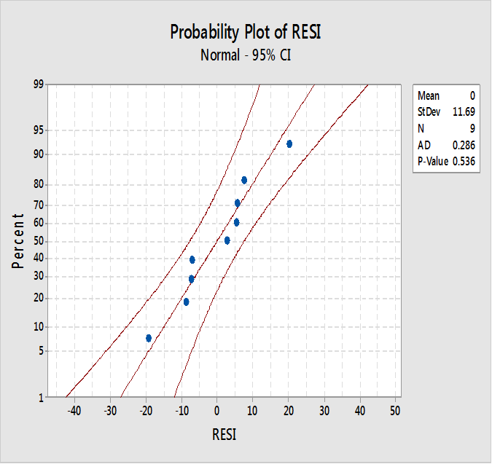
How do we check these assumptions? Assumption #2
e_{i} are normally distributed?
Q-Q plot
Examine a Q-Q plot
Do the points appear to follow in a linear pattern?
Yes – Good! This implies the errors are normally distributed

Slide 22
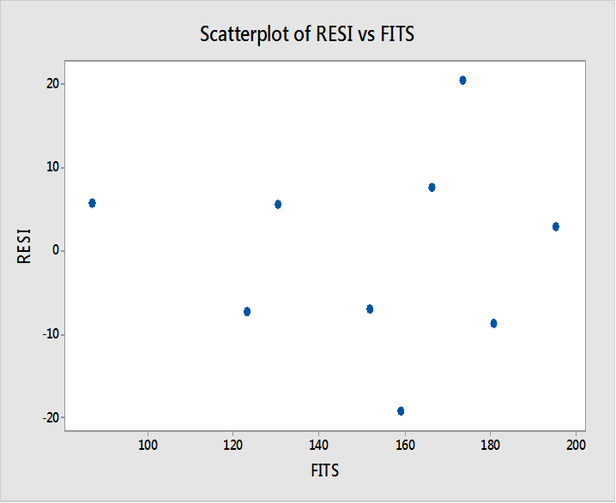
How do we check these assumptions? Assumption #3
e_{i’s} have constant variance?
Residual Plot
Examine a residual plot.
Do you see a pattern?
No – good! This implies the constant variance assumption has been met

Slide 23
How about assumptions #1 and #4?
Assumption #1
If we construct the line of best fit, the residuals must sum to zero.
Assumption #4
We must look at how the sample was selected. Did we use a simple random sample? Are the subjects independent?

Slide 24
Inferences About β₀ and β₁
We use our sample data to estimate β₀ by b₀ and β₁ by b₁. If we had a different sample, we would not be surprised to get different estimates.
Understanding how much they would vary from sample to sample is an important part of the inference process.
We use the assumptions, together with our data, to construct the sampling distributions for b₀ and b₁.

Slide 25
Tests About β₁
The most common test is that a change in the X variable does not induce a change in Y, which can be stated:
H₀: β₁ = 0
H_{a}: β₁ ≠ 0
If H₀ is true it implies the population regression equation is a flat line; that is, regardless of the value of X, Y has the same distribution.

Slide 26
t-Distribution for Inferences for β₁

Slide 27
Inference for the slope
Test Statistic =
P-value = 0.000 at df = 9-2=7

Slide 28

Confidence interval for slope
7.192 ± 2.3646(.953)
(4.938,9.445)
We are 95% confident that the slope of the line lies between 4.938 and 9.445 grams.

Slide 29
Confidence Intervals about the Regression Line
Suppose we wish to determine a confidence interval for the predicted value of Y for a given value of X.
To make an interval estimate, we need some kind of standard error.
Because our point estimate is a function of the random variables b₀ and b₁ their standard errors enter into our computation.

Slide 30
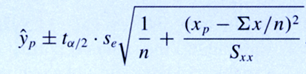
Confidence interval for a predicted value of y for a given value of x

Slide 31
Example
Obtain a 95% confidence interval for the predicted mean value of Y at the point X = 62 cm
Point estimate for ŷ = -301.087+(7.192)(62)
= 144.817
Previously, S_{xx} = 172
s_{e} = 12.4995
Mean of X = 63

Slide 32
Hence 95% CI for the predicted value of Y =
144.817 ± 10.1066
We are 95% confident that the predicted value of y when x=62 cm lies between 134.7104 to 154.9236 grams.

